Slide 2
Shell Prompt
The prompt, $, which is called the command prompt, is issued by the shell.
While the prompt is displayed, you can type a command.
Shell reads your input after you press Enter.
It determines the command you want to be executed by looking at the first word of your input. A word is an unbroken set of characters. Spaces and tabs separate words.

Slide 3
FINDING OUT YOUR SHELL
When you are provided with a UNIX account, the system administrator chooses a shell for you.
To find out which shell was chosen for you, look at your prompt.
If you have a $ prompt, you’re probably in a Bash, Bourne or a Korn shell.
If you have a % prompt, you’re probably in a C shell.

Slide 4
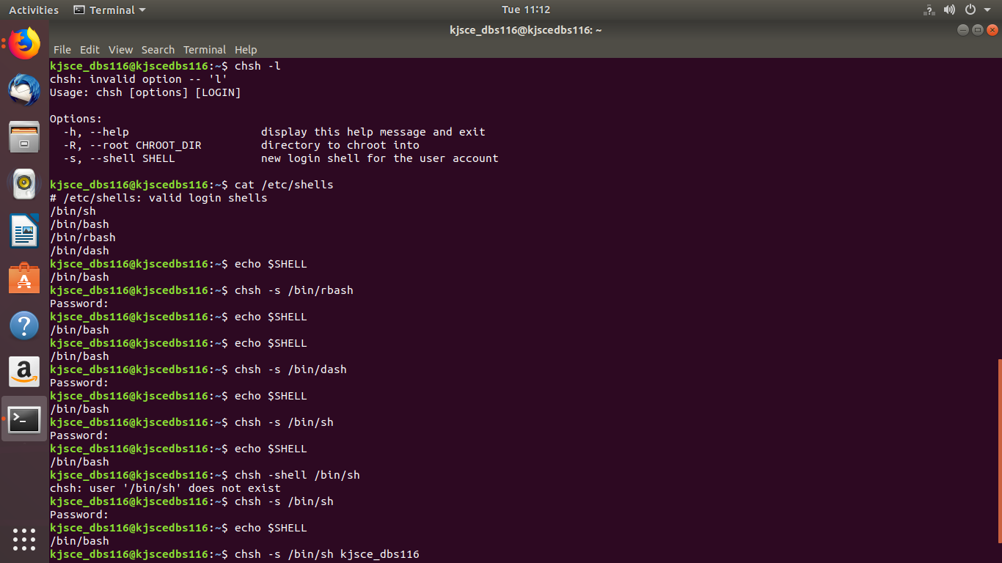
FINDING OUT YOUR SHELL
Using the Echo command

Slide 5
List all the shells on your PC?
Using the Cat command

Slide 6
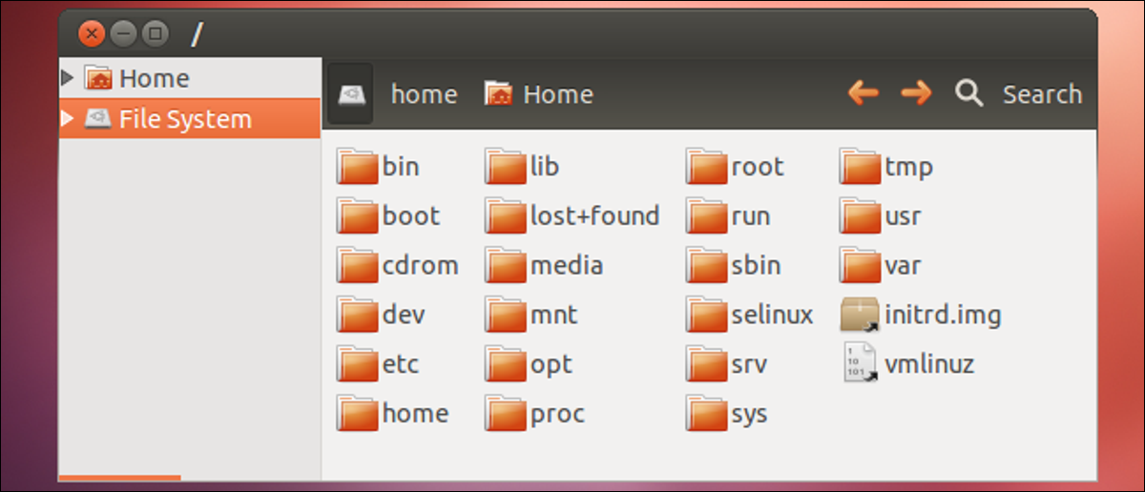
List all the shells on your PC?
The list of all the shells which are currently installed in our Linux system is stored in the ‘shells’ file which is present in /etc folder of the system.
It has read-only access by default and is modified automatically whenever we install a new shell in our system.

Slide 7
/etc — Configuration Files
The /etc directory contains configuration files, which can generally be edited by hand in a text editor.
Note that the /etc/ directory contains system-wide configuration files
User-specific configuration files are located in each user’s home directory.

Slide 8
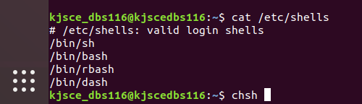
List all the shells on your PC?
The cat command displays the various installed shells along with their installation paths.

Slide 9
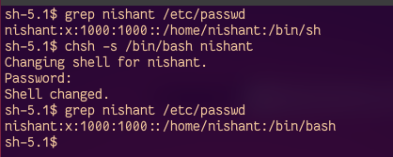
Change the shell
Using chsh Utility
chsh is the utility to change a user’s login shell. chsh provides the -s option to change the user’s shell.

Slide 10
Shell Scripting
Usually shells are interactive that mean,
they accept command as input from users and execute them.
to execute a bunch of commands routinely,
so we have to type in all commands each time in terminal.

Slide 11
Shell Scripting
As shell can also take commands
as input from file we can write these commands in a file
can execute them in shell to avoid this repetitive work.
These files are called Shell Scripts or Shell Programs.
Shell scripts are similar to the batch file in MS-DOS.
Each shell script is saved with .sh file extension eg. myscript.sh

Slide 12
Shell Scripting
A shell script have syntax just like any other programming language.
A shell script comprises following elements –
Shell Keywords – if, else, break etc.
Shell commands – cd, ls, echo, pwd, touch etc.
Functions
Control flow – if..then..else, case and shell loops etc.

Slide 13
The Shell Definition Line
The shell definition line tells the system
what shell should be used to interpret the script's commands, and
where the program (shell) is located.
The shell definition line tells the system to use the Korn Shell when executing this script.
(#!/bin/ksh)

Slide 14
Shell Script Comments
Comments, or non-command code,
In a shell script, Comments begin with the # (pound) character

Slide 15
Permissions for script
Before you can run the script, you need to make the shell script file, an executable by using the UNIX chmod command.

Slide 16
Permissions for script
The following command will allow only the user (owner) of the script to execute it:
$ chmod u+x script1
If you wanted to allow everyone (all) to execute the script, you would use this command:
$ chmod a+x script1

Slide 17
Executing script
After the script file has been made an executable with the chmod command, you can run the script in a new shell by giving the path to the script:
$ ./script1
This (./) would be the path to script1 if you are in the same directory as the script.
If you were in a different directory than the script, you could use one of the following commands to run it:
$ /home/student1/script1 or $ /bin/ksh /home/student1/script1

Slide 18
Executing script
On some online portals, Execute it as
$ sh script1.sh

Slide 19
Sample program
vi hello.sh
To go into edit mode:
press ESC and type I
To save a file
press ESC and type :w fileName
To save a file and quit:
press ESC and type :wq
Or
press ESC and type :x
Save and close the file.
You can run the script as follows:
./hello.sh
Sample outputs:
bash: ./hello.sh: Permission denied
Type chmod u+x hello.sh
And execute the program again

Slide 20
Chmod command

Slide 21
Chmod command
The 'chmod command is used to change the access permissions of a file. The syntax is as follows:
chmod ugo+rwx filename Where,
u : Users
g : Groups
o : Others
+ : Adds the permission
- : Removes the permission
= : Overwrites current permissions
r : Read permission
w : Write permission
x : Execute permission

Slide 22
Displaying Output
Two methods for displaying output to standard output:
echo "Text Line 1"
The print command is the replacement for the echo command.
You can use the print command when you are writing shell scripts because
it is more powerful than the echo command, and
its syntax has been standardized on multiple operating systems.

Slide 23
Echo command
echo - display a line of text.
Example-2:
To print value of x, where x=10.
$ echo $x
output: 10

Slide 24


Echo command
To display a line of text
test2.sh-
Output-

Slide 25
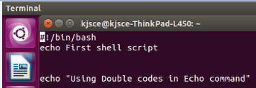

Echo command
Using double quotes with echo
test2.sh-
Output-

Slide 26
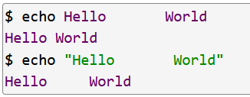
Echo command
Using double quotes with echo
That the use of double quotes (") characters affect how spaces and TAB characters are treated, for example:

Slide 27
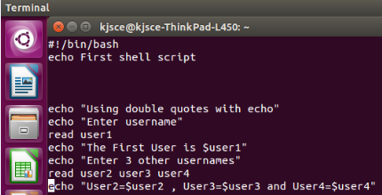
Read command
To read input from the user
test2.sh-

Slide 28
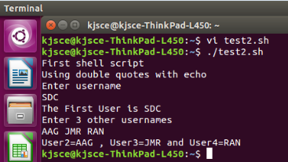
Read command
To read input from the user
test2.sh-
Output-

Slide 29
How to define variables
We can define a variable by using the syntax variable_name=value.
To get the value of the variable, add $ before the variable.

Slide 30
Arithmetic expression
Arithmetic expansion allows the evaluation of an arithmetic expression and the substitution of the result.
The format for arithmetic expansion is:
$((expression))
Reading man bash says that the old format:
$[expression]
is deprecated and will be removed.
Otherwise they should be equivalent.

Slide 31
Shell Script to Add Two Integers
#!/bin/bash
# Calculate the sum of two integers with pre initialize values
# in a shell script
a=10
b=20
sum=$(( $a + $b ))
echo $sum

Slide 32
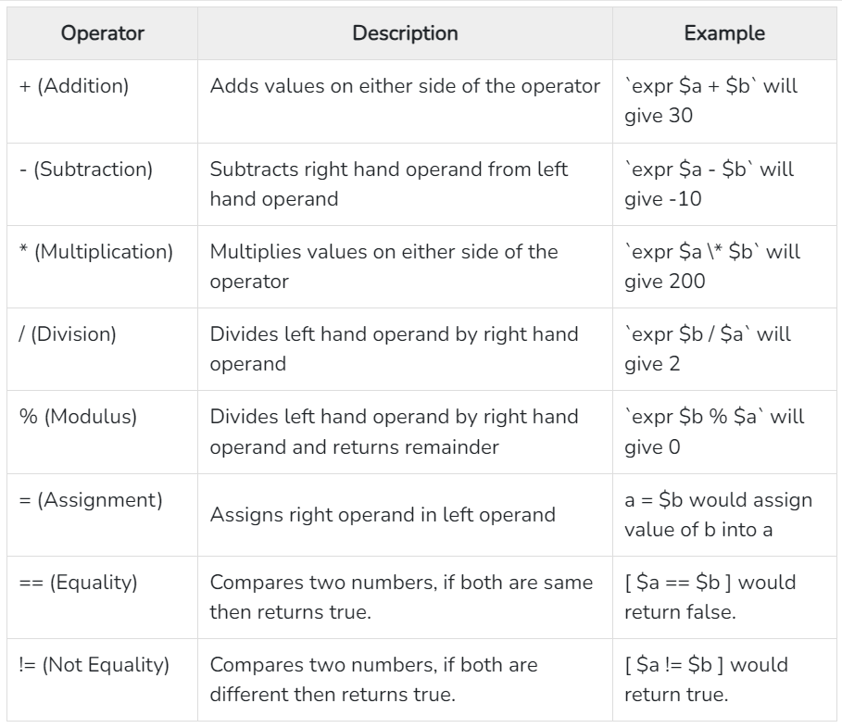
Arithmetic Operators

Slide 33
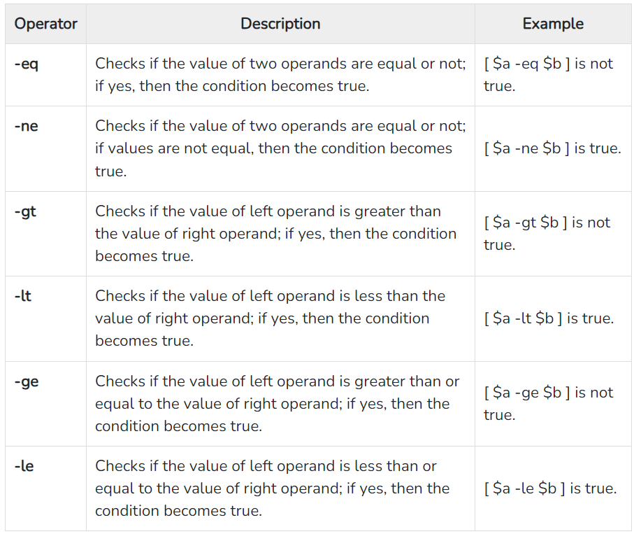
Relational Operators

Slide 34
Shell Script –Using Decision constructs
Syntax
if [ expression ]
then
Statement(s) to be executed if expression is true
else
Statement(s) to be executed if expression is not true
fi

Slide 35
Conditional Expressions
It is very important to understand that all the conditional expressions should be inside square braces with spaces around them,
For example
[ $a == $b ] is correct whereas,
[$a==$b] is incorrect.

Slide 36
Conditional Expressions
It is very important to understand that all the conditional expressions should be placed inside square braces with spaces around them.
For example,
[ $a <= $b ] is correct whereas,
[$a <= $b] is incorrect.

Slide 37
Conditional Expressions
-lt is Less than which is used for condition checking
< is used for Reading input from the files.
The statement [ $num < 10 ] is just syntactic sugar for the command test $num < 10, which means:
Run the command test with one parameter (the content of the shell variable num), and
associate the standard input of this invocation with a file named 10

Slide 38
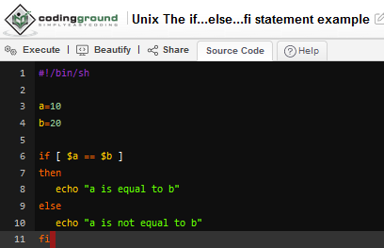

Shell Script –Using Decision constructs
Example-
Output-

Slide 39
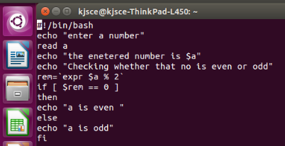
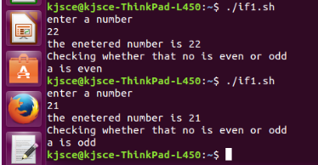
Shell Script to check if a number is even or odd
Output-
expr is an external program used by Bourne shell.
It uses expr external program with the help of backtick.
The backtick(`) is actually called command substitution.

Slide 40
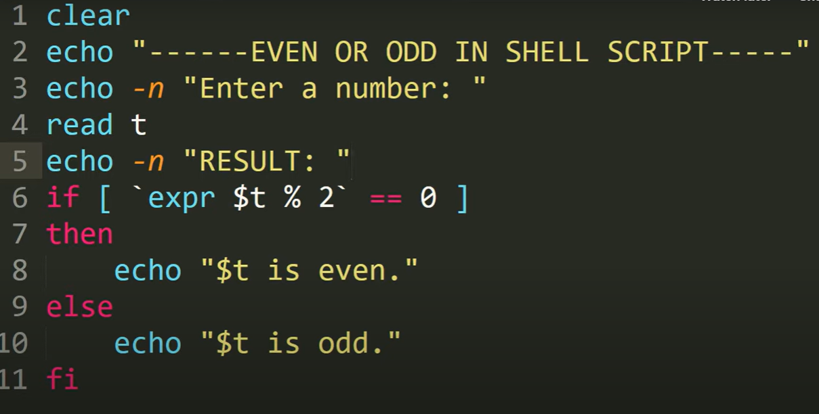
Shell Script to check if a number is even or odd

Slide 41
Shell Script to calculate hra and ta

Slide 42
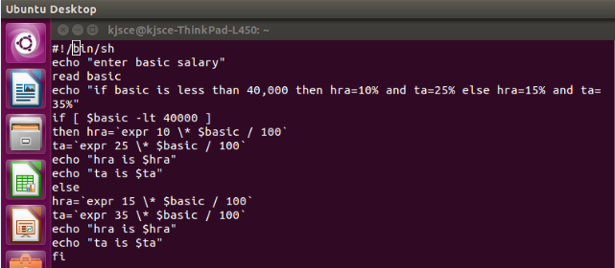
Shell Script to calculate hra and ta
expr is an external program used by Bourne shell.
It uses expr external program with the help of backtick.
The backtick(`) is actually called command substitution.

Slide 43
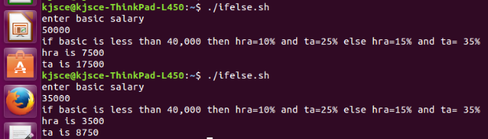
Shell Script to calculate hra and ta
Output-

Slide 44
The backslash (\) character is used to mark these special characters so that they are not interpreted by the shell, but passed on to the command being run (for example, echo).

Slide 45
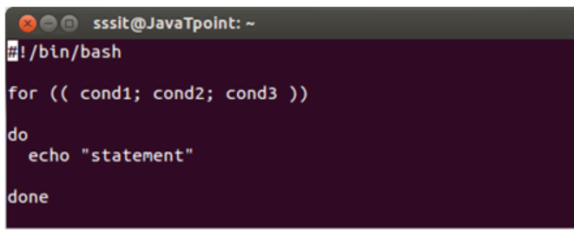
For Loop Syntax
condition1 indicates initialization,
cond2 indicates condition and cond3 indicates updation.

Slide 46
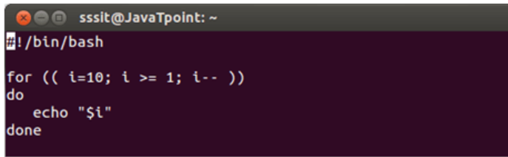
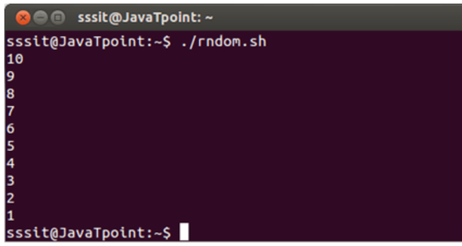
For Loop Eg
O/P-

